Slide 1
Waste management – citizens engagement
Fragiskos Fourlas (1059336)
Marios Stamatopoulos (1059383)
Nikos Panagiotopoulos (1053552)

Slide 2
OUTLINE
Problem
Solution
Market Fill
Market Gap
Our Proposal

Slide 3
Workload Allocation
Gateways/Devices, Prediction, Reward System
(Fragiskos Fourlas)
Optimal Route, Server Structure, Database
(Marios Stamatopoulos)
Frontend Design and Structure, Data Analysis
(Nikos Panagiotopoulos)

Slide 4
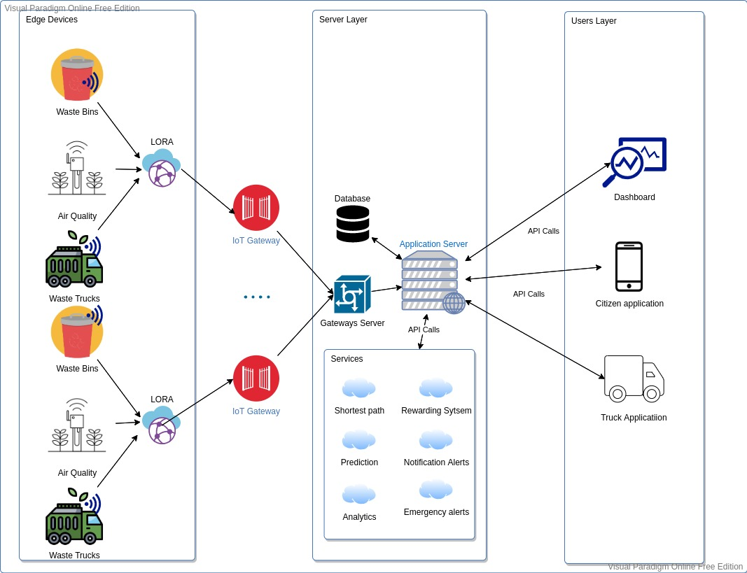
Our Proposal

Slide 5
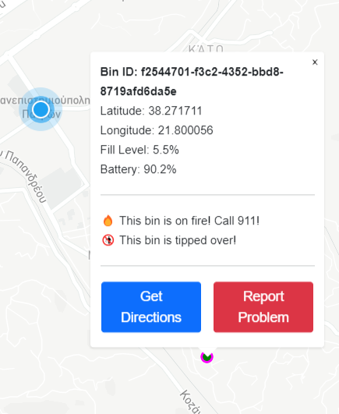
Dummy Sensors
Dummy Sensors Server
Collects data from the gateway and publishes it to the server
Handles API calls for I/O
Sensor Gateway
Works in the place of an actual IoT Gateway
Runs processes containing sensors
Transfers messages between sensors and server via pipes
Sensors
Have a unique identifying UUIDv4
Scatter themselves around a fixed center point
Update and publish mock data with a unique “measurement ID” each interval
Chance to fall or catch fire every interval

Slide 6
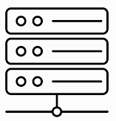
SERVER
FLASK FRAMEWORK
SQL ALCHEMY
SQLite Database
Handling all HTTP requests from and to services
Sensors gateways
Front-end
Rewarding system, Fleet routing optimization , Bounties
Implementing functions that need Database interface

Slide 7

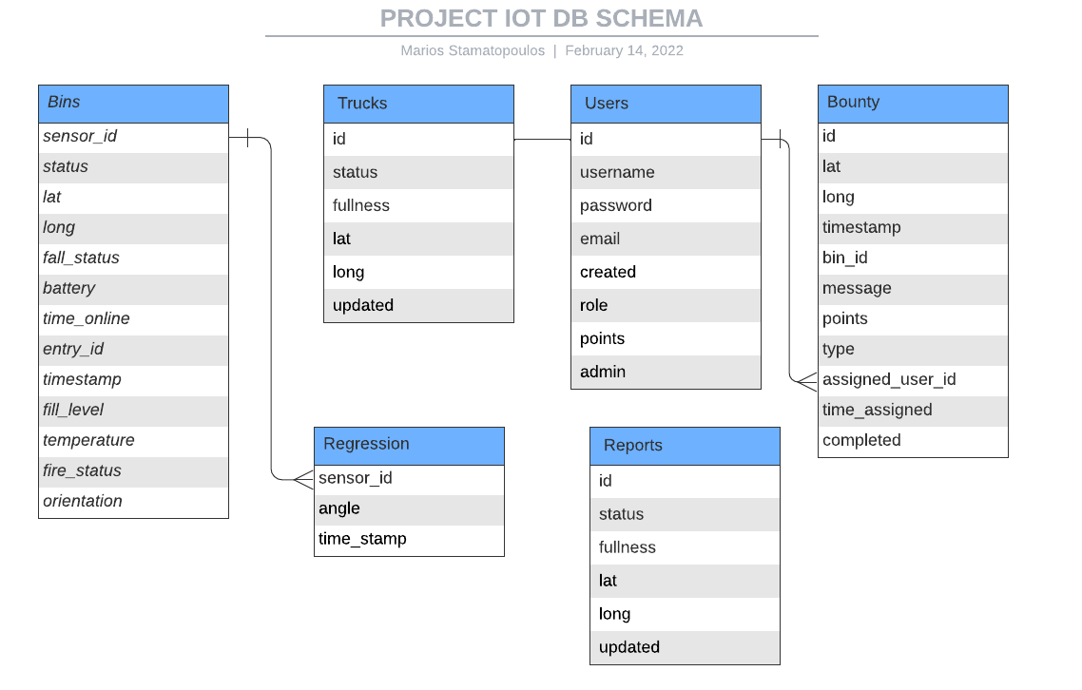
Database schema

Slide 8
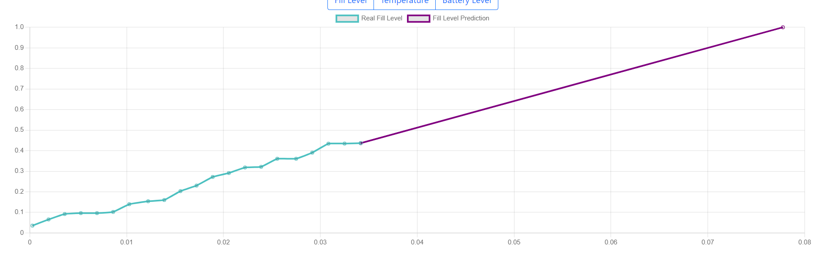
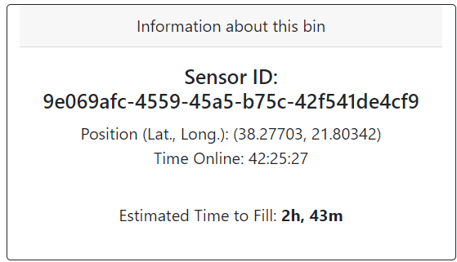
Regression Prediction
Uses measurement history to predict a fill rate
Prediction is calculated per sensor and saved individually in a DB table
If retrieved regression model is too old, prediction is recalculated and updated before response

Slide 9

TRUCK FLEET ROUTING
Check all available trucks at the moment
Check all bins that need pickup
Transform it into travelling salesman problem (GraphHopper)
Each truck is assigned to specific bins
Calculating directions for every truck and send them as JSON (Mapbox API)

Slide 10
Citizen Engagement – Point System
Announce Bounty
(e.g. Tilting bin, Empty battery)
Award Points
Citizens Redeem for Vouchers

Slide 11
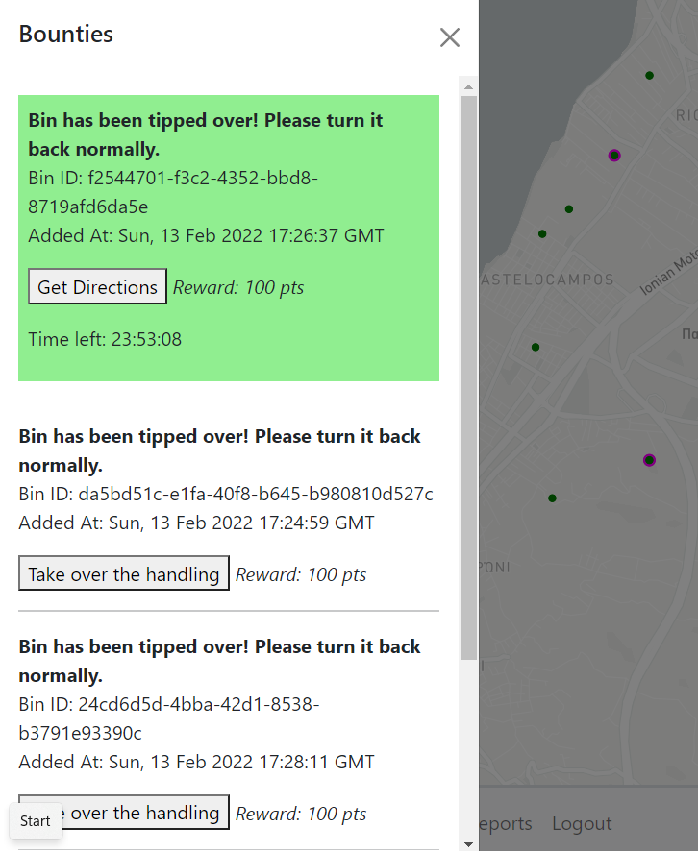
Bounties
Generation
A bounty is automatically generated when a bin makes a problematic measurement
Support for future development: Admin generated bounties for any purpose
User Interaction
User can find bounties in a radius around him
User accepts a bounty and has some time to complete it
User can find a list of his assigned bounties in his profile, mark it complete and receive the reward points or abandon

Slide 12
Known Issues
Major
Dummy Sensors bug (Launching creates 2 SensorGateways can only communicate with one)
Minor
Buttons on home page do not work, need to press “CleanerCity App” on the nav-bar
Fill level on bin history graph doesn’t display x-axis time
Some visuals don’t auto refresh

Slide 13

Questions?

